Slide 1
Templates in C++
Template function in C++ makes it easier to reuse classes and functions.
A template can be viewed as a variable that can be instantiated to any data type, irrespective of whether this data type is a fundamental C++ type or a user-defined type.

Slide 2
Selection Sort Template
Template <class KeyType>
void sort(KeyType *a, int n)
// sort the n KeyTypes a[0] to a[n-1] into nondecreasing order
{
for (int i = 0; i < n; i++)
{
int j = i;
// find smallest KeyType in a[i] to a[n-1]
for (int k = i+1; k < n; k++)
if (a[k] < a[j]) { j = k;}
// interchange
KeyType temp = a[i]; a[i] = a[j]; a[j] = temp;
}
}
float farray[100];
int intarray[200];
………..
sort(farray, 100);
sort(intarray, 200);

Slide 3
Template (Cont.)
Can we use the sort template for the Rectangle class?
Well, not directly. We’ll need to use operator overloading to implement “>” for Rectangle class.

Slide 4
Stack
What is a stack? A stack is an ordered list in which insertions and deletions are made at one end called the top. It is also called a Last-In-First-Out (LIFO) list.

Slide 5
Stack (Cont.)
Given a stack S = (a₀, …, a_{n-1}), a₀ is the bottom element, a_{n-1} is the top element, and a_{i} is on top of element a_{i-1}, 0 < i < n.
a₃
a₃
a₂
a₂
a₁
a₁
a₀
a₀
Push (Add)
Pop (Delete)

Slide 6
System Stack
Whenever a function is invoked, the program creates a structure, referred to as an activation record or a stack frame, and places it on top of the system stack.
previous frame pointer
fp
return address
a1
local variables
previous frame pointer
fp
previous frame pointer
return address
main
return address
main

Slide 7
ADT 3.1 Abstract Data Type Stack
Template <class KeyType>
class Stack
{ // objects: A finite ordered list with zero or more elements
public:
Stack (int MaxStackSize = DefaultSize);
// Create an empty stack whose maximum size is MaxStackSize
Boolean IsFull();
// if number of elements in the stack is equal to the maximum size
// of the stack, return TRUE(1) else return FALSE(0)
void Add(const KeyType& item);
// if IsFull(), then StackFull(); else insert item into the top of the stack.
Boolean IsEmpty();
// if number of elements in the stack is 0, return TRUE(1) else return FALSE(0)
KeyType* Delete(KeyType& );
// if IsEmpty(), then StackEmpty() and return 0;
// else remove and return a pointer to the top element of the stack.
};

Slide 8
Implementation of Stack by Array
a_{n-1}
a₂
a₁
a₀
a₀
a₁
a₂
a_{n-1}
Array index
0
1
2
3
n-1

Slide 9
Queue
A queue is an ordered list in which all insertions take place at one end and all deletions take place at the opposite end. It is also known as First-In-First-Out (FIFO) lists.
a₀
a₁
a₂
a_{n-1}
front
rear

Slide 10
ADT 3.2 Abstract Data Type Queue
Template <class KeyType>
class Queue
{
// objects: A finite ordered list with zero or more elements
public:
Queue(int MaxQueueSize = DefaultSize);
// Create an empty queue whose maximum size is MaxQueueSize
Boolean IsFull();
// if number of elements in the queue is equal to the maximum size of
// the queue, return TRUE(1); otherwise, return FALSE(0)
void Add(const KeyType& item);
// if IsFull(), then QueueFull(); else insert item at rear of the queue
Boolean IsEmpty();
// if number of elements in the queue is equal to 0, return TRUE(1)
// else return FALSE(0)
KeyType* Delete(KeyType&);
// if IsEmpty(), then QueueEmpty() and return 0;
// else remove the item at the front of the queue and return a pointer to it
};

Slide 11
Queue Manipulation Issue
It’s intuitive to use array for implementing a queue. However, queue manipulations (add and/or delete) will require elements in the array to move. In the worse case, the complexity is of O(MaxSize).

Slide 12
Shifting Elements in Queue
front
rear
front
rear
front
rear

Slide 13
Circular Queue
To resolve the issue of moving elements in the queue, circular queue assigns next element to q[0] when rear == MaxSize – 1.
Pointer front will always point one position counterclockwise from the first element in the queue.
Queue is empty when front == rear. But it is also true when queue is full. This will be a problem.

Slide 14
Circular Queue (Cont.)
4
J4
4
J3
n-4
n-4
3
3
J2
J1
n-3
J2
n-3
2
J1
2
J3
n-2
J4
n-2
1
1
0
n-1
0
n-1
front = 0; rear = 4
front = n-4; rear = 0

Slide 15
Circular Queue (Cont.)
To resolve the issue when front == rear on whether the queue is full or empty, one way is to use only MaxSize – 1 elements in the queue at any time.
Each time when adding an item to the queue, newrear is calculated before adding the item. If newrear == front, then the queue is full.
Another way to resolve the issue is using a flag to keep track of last operation. The drawback of the method is it tends to slow down Add and Delete function.

Slide 16
Subtyping and Inheritance in C++
Inheritance is used to express subtype relationships between two ADTs.
If B inherits from A, then B IS-A A. Also, A is more general than B.
  VW Beetle IS-A Car; Eagle IS-A Bird

Slide 17
Inheritance
A derived class inherits all the non-private members (data and functions) of the base class.
Inherited members from public inheritance have the same level of access in the derived class as they did in the base class.
The derived class can reuse the implementation of a function in the base class or implement its own function, with the exception of constructor and destructor.

Slide 18
Class Inheritance Example
class Bag
{ public:
Bag (int MaxSize = DefaultSize); // constructor
virtual ~Bag(); // destructor
virtual void Add(int); // insert element into bag
virtual int* Delete (int&); //delete element from bag
virtual Boolean IsFull(); // return TRUE if the bag is full; FALSE otherwise
virtual Boolean IsEmpty(); // return TRUE if the bag is empty; FALSE otherwise
protected:
virtual void Full(); // action when bag is full
virtual void Empty(); // action when bag is empty
int *array;
int MaxSize; // size of array
int top; // highest position in array that contains an element
}

Slide 19
Class Inheritance Example(Cont.)
class Stack : public Bag
{
public:
Stack(int MaxSize = DefaultSize); // constructor
~Stack(); // destructor
int* Delete(int&); // delete element from stack
};
Stack:: Stack (int MaxStackSize) : Bag(MaxStackSize) { }
// Constructor for Stack calls constructor for Bag
Stack::~Stack() { }
// Destructor for Bag is automatically called when Stack is destroyed. This ensures that array is deleted.
int* Stack::Delete(int& x)
{ if (IsEmpty()) {Empty(); return 0; }
x = array[top--];
return &x;
}

Slide 20
Class Inheritance Example (Cont.)
Bag b(3); // uses Bag constructor to create array of size 3
Stack s(3); // uses Stack constructor to create array of size 3
b.Add(1); b.Add(2); b.Add(3);
// use Bag::Add. Bag::Add calls functions Bag::IsFull and Bag::Full
s.Add(1); s.Add(2); s.Add(3);
// Stack::Add not defined, so use Bag::Add. Bag::Add calls Bag::IsFull
// and Bag::Full because these have not been redefined in Stack
int x;
b.Delete(x); // uses Bag::Delete, which calls Bag::IsEmpty and Bag::Emtpy
s.Delete(x);
// uses Stack::Delete, which calls Bag::IsEmtpy and Bag::Emtpy because these
// have not been redefined in Stack.

Slide 21
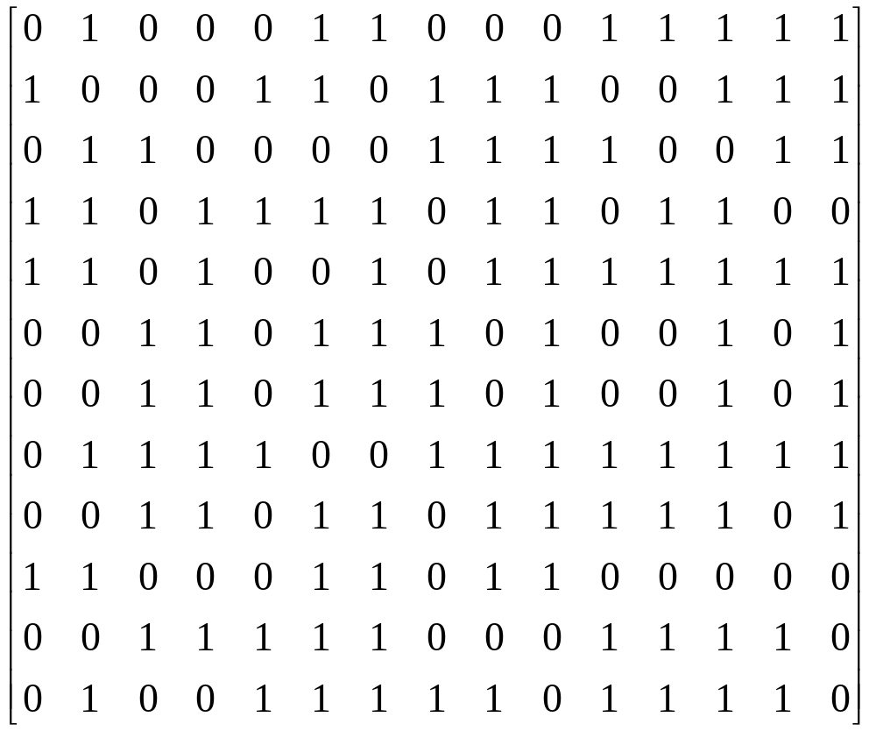
The Maze Problem
Entrance
Exit

Slide 22
Allowable Moves
N
[i-1][j-1]
[i-1][j]
[i-1][j+1]
NW
NE
W
[i][j-1]
X
[i][j+1]
E
[i][j]
[i+1][j-1]
[i+1][j]
[i+1][j+1]
SW
S
SE

Slide 23
The Maze Problem (Cont.)
Stack is used in solving the maze problem for storing the coordinates and direction.
Use of another mxp array to mark any position that has been visited before.

Slide 24
Evaluation Expression in C++
When evaluating operations of the same priorities, it follows the direction from left to right.
Priority | Operator
1 | Unary minus, !
2 | *, /, %
3 | +, -
4 | <, <=, >=, >
5 | ==, !=
6 | &&
7 | ||

Slide 25
Postfix Notation
Expressions are converted into Postfix notation before compiler can accept and process them.
X = A/B – C + D * E – A * C
Infix A/B–C+D*E–A*C
Postfix => AB/C-DE*+AC*-
Operation | Postfix
T₁ = A / B | T₁C-DE*+AC*-
T₂ = T₁ - C | T₂ DE*+AC*-
T₃ = D * E | T₂T₃+AC*-
T₄ = T₂ + T₃ | T₄AC*-
T₅ = A * C | T₄ T₅ -
T₆ = T₄ - T₅ | T₆

Slide 26


Multiple Stacks and Queues
Two stacks case:
More than two stacks case
0
1
2
3
4
m-4
m-3
m-2
m-1
Stack A
Stack B
0
m-1
b[0]
b[1]
b[2]
b[n]
t[0]
t[1]
t[2]
t[n]

